Slide 1
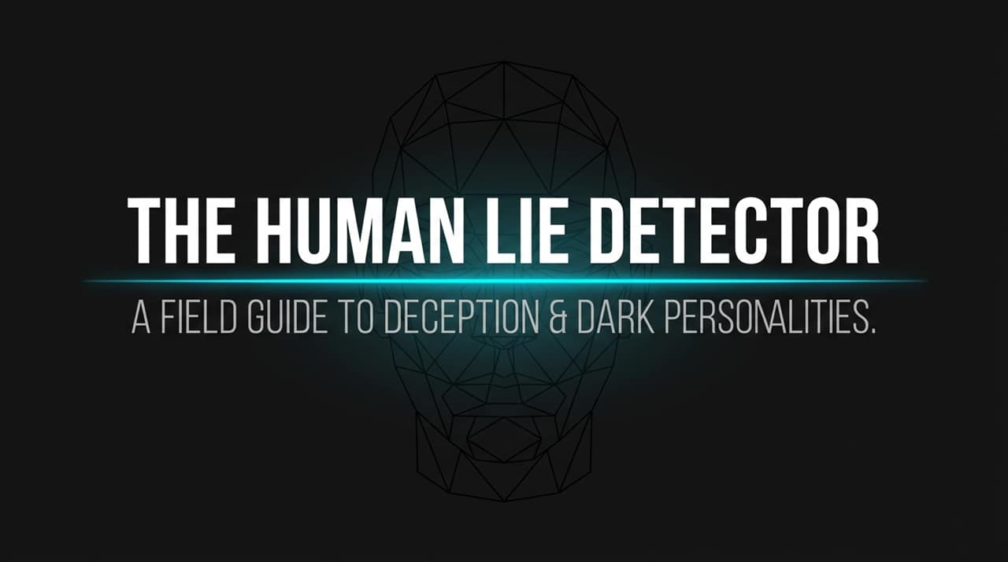
Notes:
Introduction & Hook: Welcome everyone. Today, we’re stepping into the field guide to deception and dark personalities. We often imagine dark traits in extreme, cinematic terms—a movie villain or an obvious criminal. But in everyday life, from corporate boardrooms to relationships, these dynamics are much more subtle and widespread.
The Core Paradox: The primary goal today is not to make us cynical about humanity, but to empower us. Most people navigate the world with baseline empathy and assume others operate under the same moral code. Understanding deception and dark traits gives us a realistic framework to protect our organizations, teams, and mental well-being.
Roadmap: Over this session, we will break down the statistics of dark traits, debunk popular deception myths, examine the cognitive mechanics of lying, profile the "Dark Tetrad," and establish an actionable action framework for managing high-risk individuals.
https://www.youtube.com/watch?v=AcK_zgJjnoo

Slide 2
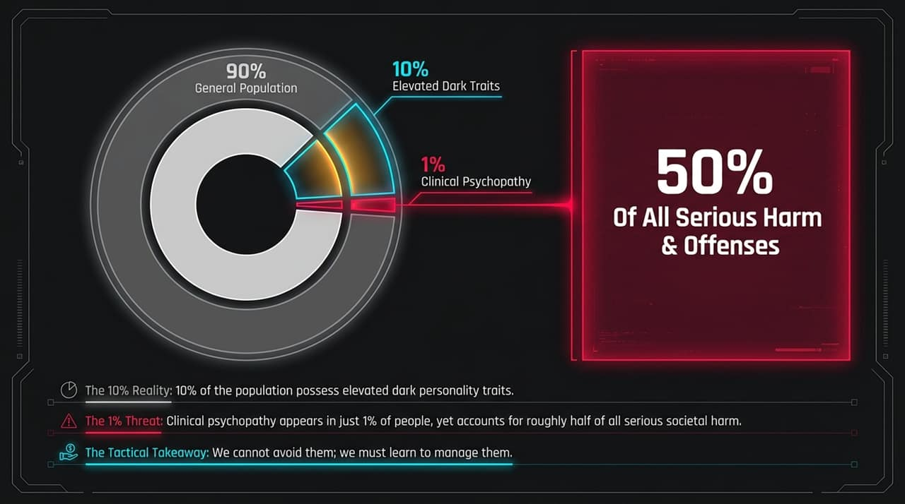
Notes:
Demographic Breakdown: Look at the distribution on this slide:
90% General Population: The vast majority of people operate with standard social reciprocity, empathy, and general honesty.
10% Elevated Dark Traits: One in ten individuals exhibits elevated, sub-clinical dark traits. They are scattered across our workplaces, leadership positions, and social circles.
1% Clinical Psychopathy: Only about 1% of the population meets the strict criteria for clinical psychopathy.
The Asymmetric Impact: Notice the statistic at the bottom—that 1% clinical tier is disproportionately responsible for roughly 50% of all serious harm and offenses.
The Tactical Takeaway: You cannot simply "avoid" these personalities—statistically, you will manage, report to, hire, or work alongside them. The goal isn't avoidance; it’s early identification, strategic boundary setting, and risk mitigation.

Slide 3
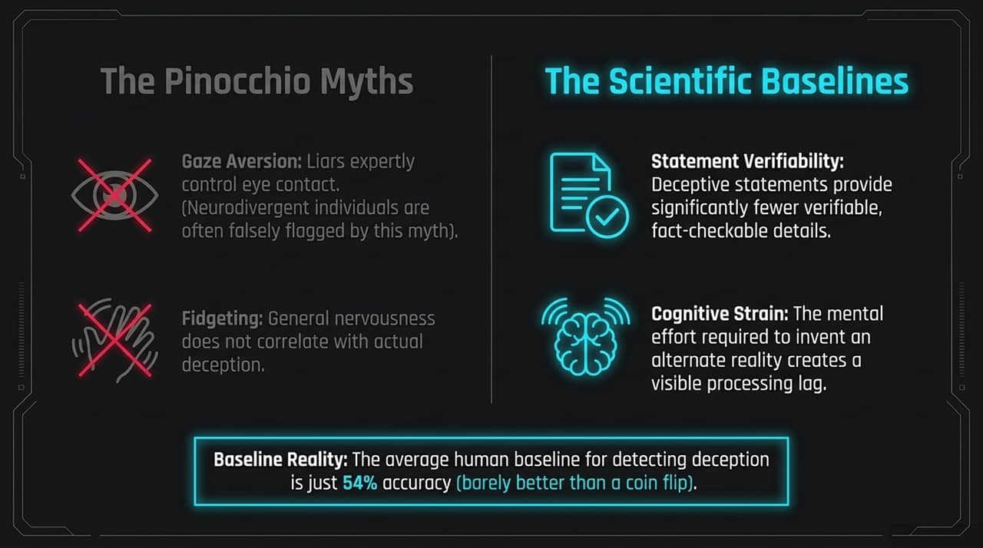
Notes:
The Human Baseline: The average person’s ability to detect a lie in real time is 54%—essentially a coin flip. Why are we so bad at it? Because we rely on widespread cultural myths rather than empirical science.
Myth #1: Gaze Aversion: Ask anyone what a liar looks like, and they’ll tell you "they can't look you in the eye". Empirical research proves this is completely false. Accomplished liars frequently maintain intentional, controlled eye contact. Furthermore, falsely equating eye contact avoidance with lying often unfairly flags neurodivergent individuals.
Myth #2: Fidgeting: We associate fidgeting with guilt, but it merely signals general physiological arousal or nervousness, not deception.
Scientific Baselines:
Statement Verifiability: Liars naturally offer fewer verifiable, fact-checkable details because details create legal or logical traps.
Cognitive Strain: Lying requires creating a secondary narrative while holding the truth in memory, producing noticeable processing lags.

Slide 4
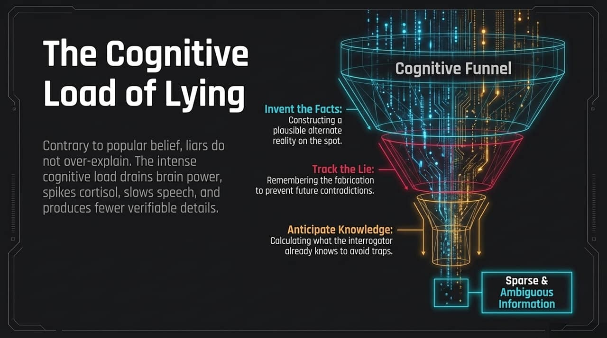
Notes:
Mental Mechanics: Contrary to popular belief, unprompted liars usually do not over-explain or chatter endlessly. Constructing an alternative reality places a severe tax on the brain's executive processing centers.
The Cognitive Funnel:
Inventing Facts: Constructing a plausible alternate reality on the spot.
Tracking the Lie: Remembering the exact fabrication so they don't contradict themselves later.
Anticipating Knowledge: Constantly calculating what the interrogator or listener already knows to avoid obvious traps.
Physiological & Verbal Signals: This internal cognitive strain drains brain power, spikes cortisol, slows speech tempo, and forces the speaker to default to sparse, ambiguous, and non-committal descriptions.

Slide 5
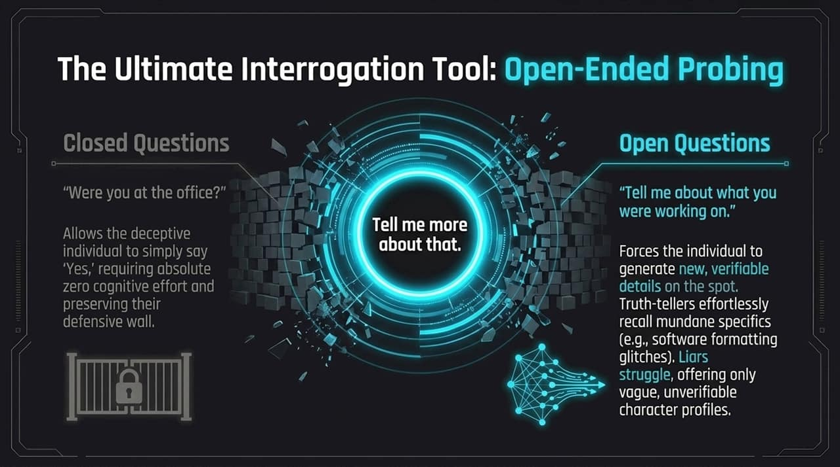
Notes:
Closed vs. Open Questions:
Closed Questions (e.g., "Were you at the office?") allow a deceptive person to give a simple "Yes" or "No". This requires zero cognitive effort and lets them maintain their defensive posture.
Open Questions (e.g., "Tell me about what you were working on") force the individual to generate detailed narratives on the spot.
The Strategic Prompt: The phrase "Tell me more about that" is one of the most effective tools in deception detection.
Differentiating Responses:
Truth-tellers: Effortlessly recall mundane, spontaneous specifics (e.g., complaining about software bugs, formatting issues, or minor interruptions).
Liars: Struggle under the sudden cognitive load, offering vague generalizations, script-like answers, or unprovable details.

Slide 6
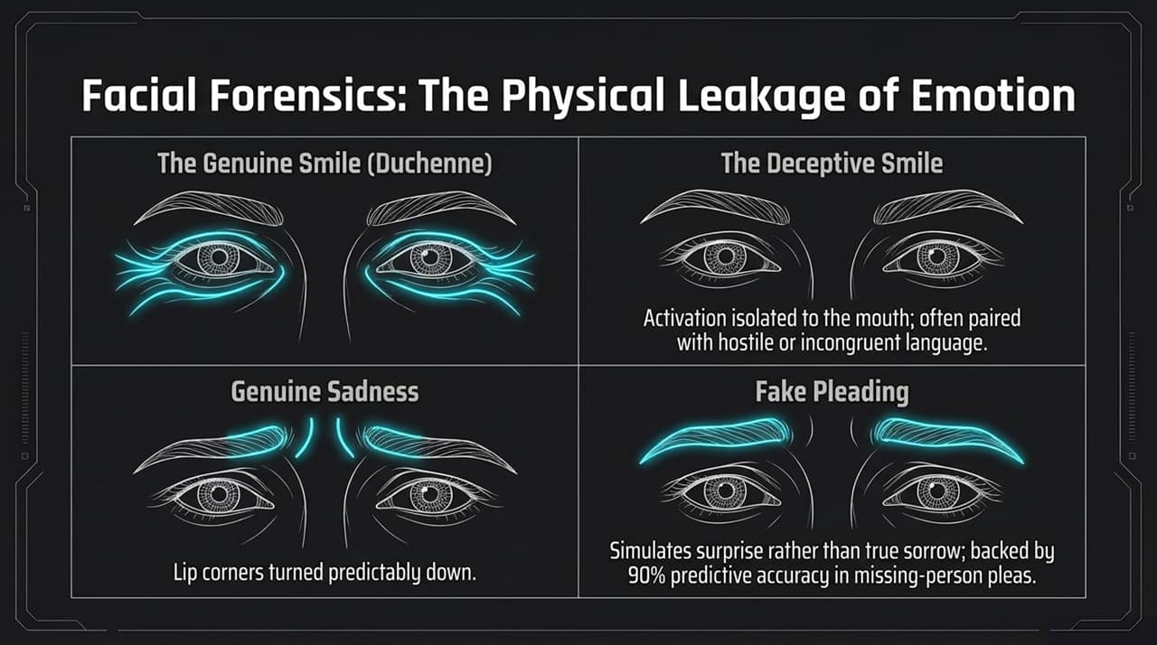
Notes:
Micro-Expressions & Facial Muscles: True emotion leaks out through micro-expressions that are controlled by involuntary facial muscles.
Smiles (Genuine vs. Deceptive):
The Duchenne (Genuine) Smile: Involves both the zygomaticus major (raising the mouth corners) and the orbicularis oculi (crinkling around the eyes).
Deceptive Smile: Isolated solely to the lower face and mouth. The eyes remain flat or cold, often paired with incongruent or aggressive speech.
Sadness & Pleading:
Genuine Sadness: Shows predictable downward pulls at the lip corners and subtle inner-eyebrow pulling.
Fake Pleading: Often features raised, flat brows—simulating surprise or drama rather than actual grief. In studies of public missing-person pleas, this facial distortion carries high predictive accuracy for deceptive intent.

Slide 7
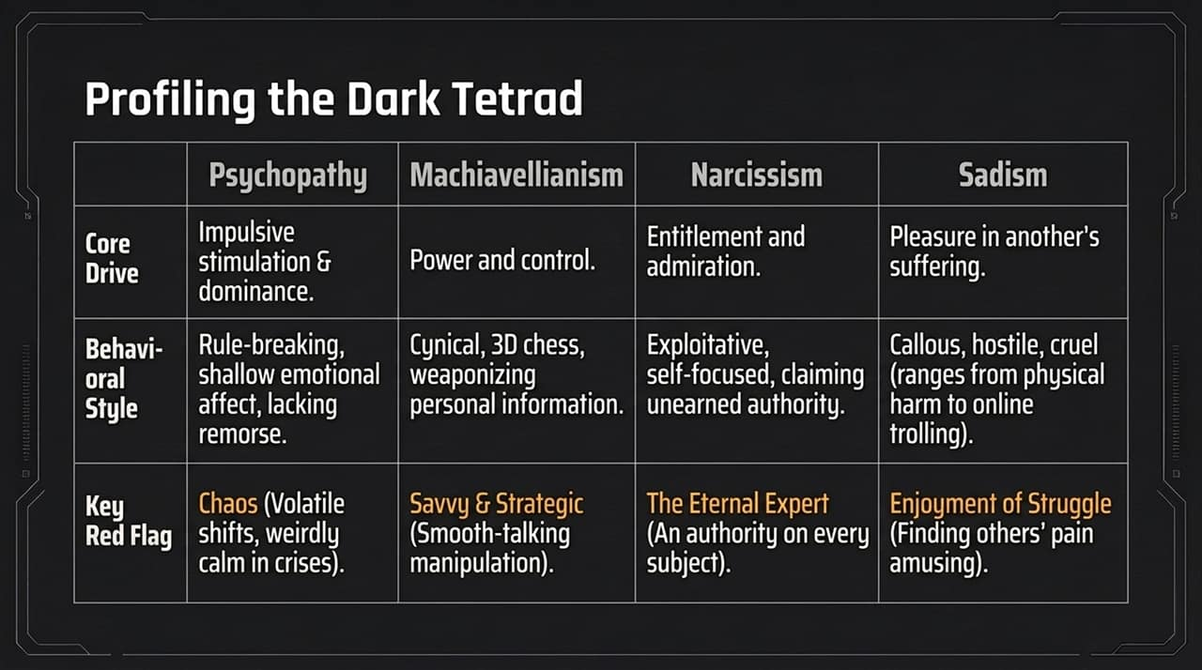
Notes:
Overview of the 4 Profiles: The Dark Tetrad consists of Psychopathy, Machiavellianism, Narcissism, and Sadism.
Deconstructing Each Trait:
Psychopathy: Driven by impulsive stimulation and dominance. Characterized by shallow emotional affect, rule-breaking, and zero remorse. Red Flag: Chaotic behavior—they can be wildly volatile or unnaturally calm in genuine crises.
Machiavellianism: Driven by long-term power, strategic control, and "3D chess" manipulation. They collect personal information to use as strategic leverage later. Red Flag: The smooth-talking, hyper-strategic operator.
Narcissism: Driven by entitlement and constant admiration. Exploitative and self-focused. Red Flag: "The Eternal Expert" who claims authority on every subject.
Sadism: Driven by pleasure in another person's emotional, social, or physical suffering. Red Flag: A subtle enjoyment of others' struggles or pain.

Slide 8
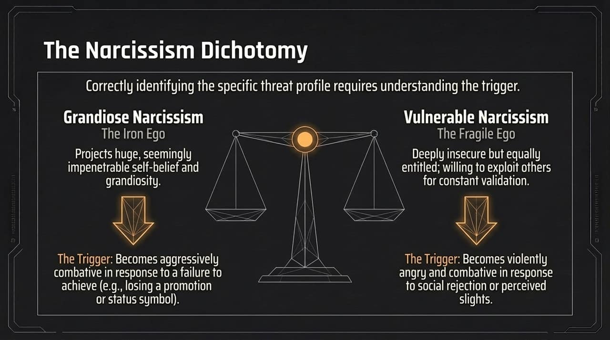
Notes:
Two Distinct Expressions: Narcissism isn't one-size-fits-all; identifying the specific type helps predict how and when an individual will strike.
Grandiose Narcissism ("The Iron Ego"): Projects immense self-belief, charm, and invulnerability.
Primary Trigger: Failure to achieve or loss of status. When denied a promotion, title, or public recognition, they become aggressively combative to protect their self-image.
Vulnerable Narcissism ("The Fragile Ego"): Deeply insecure, hypersensitive, yet feels highly entitled. They rely heavily on constant external validation.
Primary Trigger: Social rejection or minor slights. A casual critique or perceived social snub can trigger disproportionate hostility or vindictive behavior.

Slide 9
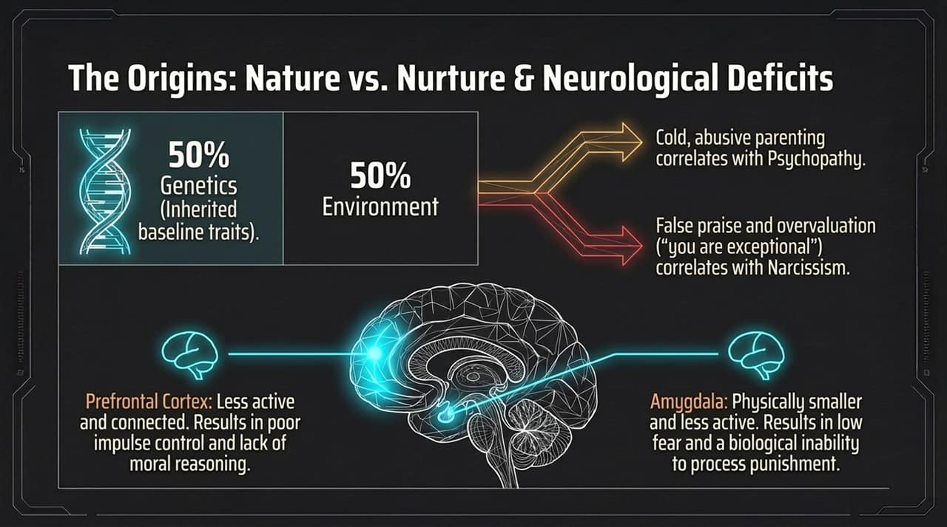
Notes:
The 50/50 Split: Behavioral genetics show dark traits are roughly 50% inherited baseline traits and 50% environmental development.
Environmental Influences: Cold, indifferent, or abusive parenting strongly correlates with adult psychopathy. Conversely, overvaluation and unearned praise ("you are inherently superior to others") correlate strongly with narcissism.
Neurological Differences:
Prefrontal Cortex: Shows lower activity and reduced connectivity, leading to poor impulse control and impaired moral reasoning.
Amygdala: Physically smaller and hypo-active. This results in an abnormally low fear response and an inability to learn from punishment or negative reinforcement.

Slide 10
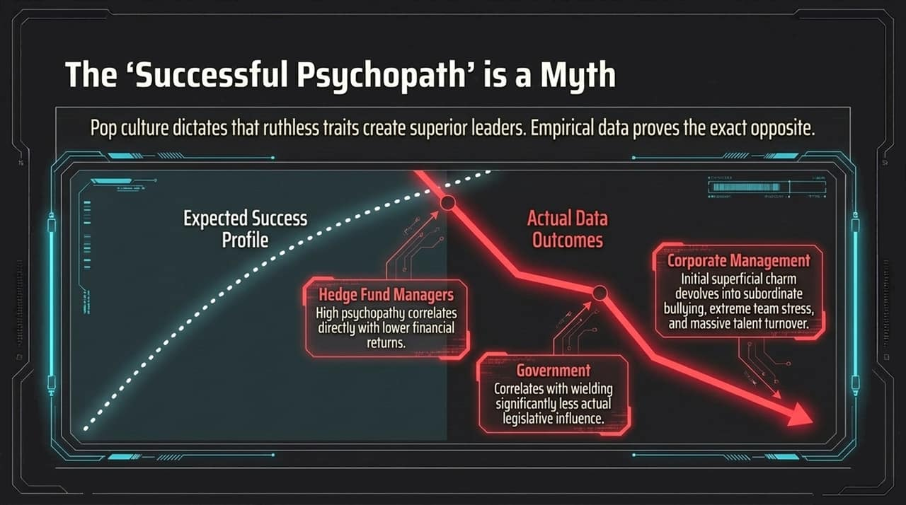
Notes:
Challenging Pop Culture: Movies and media often suggest that cold, ruthless traits produce high-performing executives, financial geniuses, and decisive leaders. Empirical research proves the exact opposite.
Real-World Data:
Hedge Fund Managers: Research tracking fund managers found higher psychopathic traits directly correlated with lower financial returns.
Government & Politics: High dark traits correlate with less actual legislative influence and compromised deal-making ability.
Corporate Management: Initial charm quickly degrades into workplace bullying, team distress, and high turnover.
Takeaway: Ruthlessness creates chaos and destruction, not sustainable leadership.

Slide 11
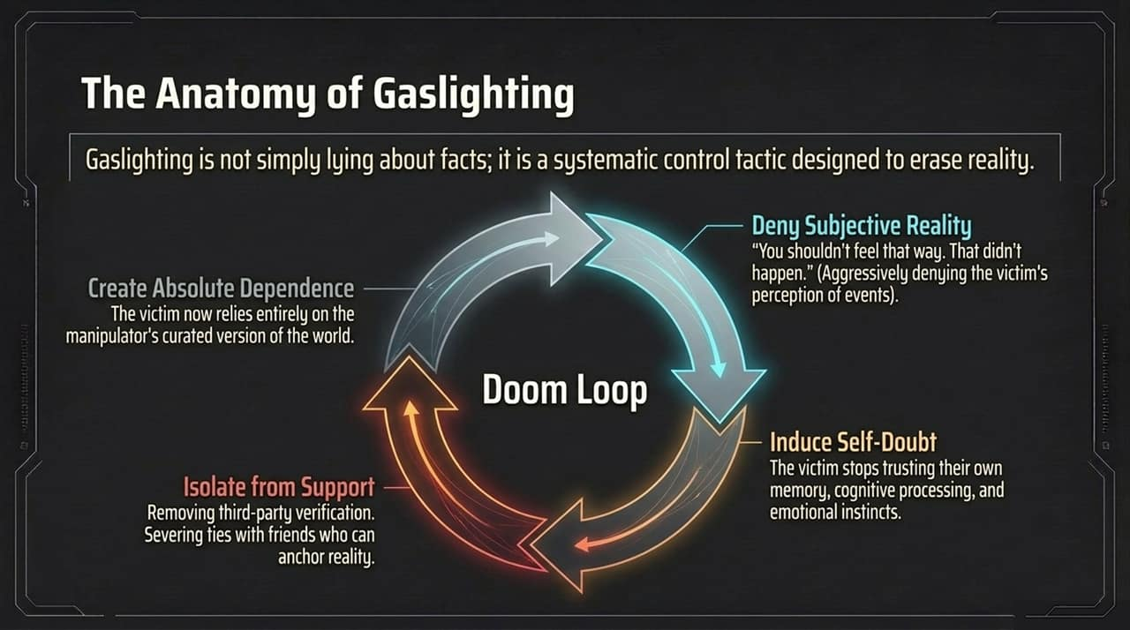
Notes:
Defining Gaslighting: Gaslighting is not a simple disagreement over facts; it is a systematic tactic to undermine a victim's trust in their own perception of reality.
The Four-Stage Doom Loop:
Deny Subjective Reality: Aggressively dismissing facts or feelings ("That never happened," "You're misremembering").
Induce Self-Doubt: The victim begins doubting their own memory, judgment, and emotional responses.
Isolate from Support: Severing ties with friends, colleagues, or advisors who could provide objective reality-checks.
Create Absolute Dependence: The victim relies entirely on the manipulator's version of reality to feel secure.

Slide 12
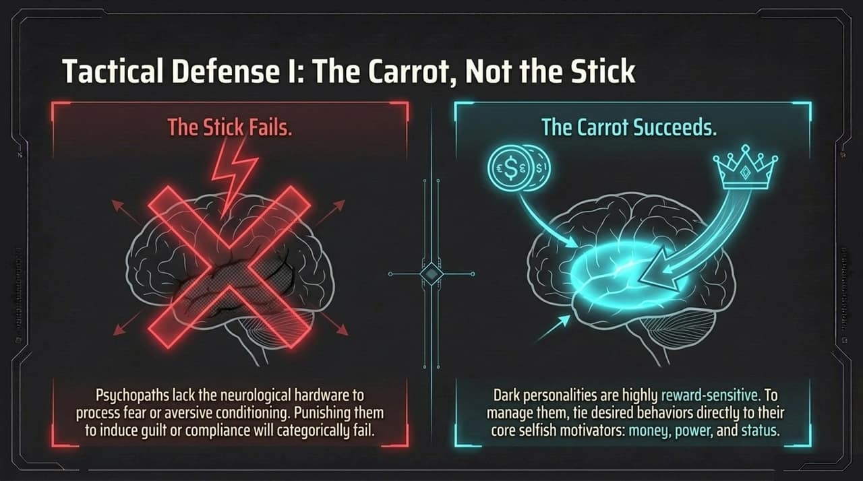
Notes:
Why the Stick Fails: Threatening, punishing, or appealing to guilt does not work on psychopathic or highly dark personalities. Because of their amygdala deficits, they lack the neurological hardware to register fear or moral remorse.
Why the Carrot Succeeds: Dark personalities are highly reward-driven.
Tactical Application: To influence or manage their behavior, align desired organizational outcomes directly with their selfish motivators—such as financial incentives, prestige, or status. Frame compliance as a path to personal gain rather than an ethical duty.

Slide 13
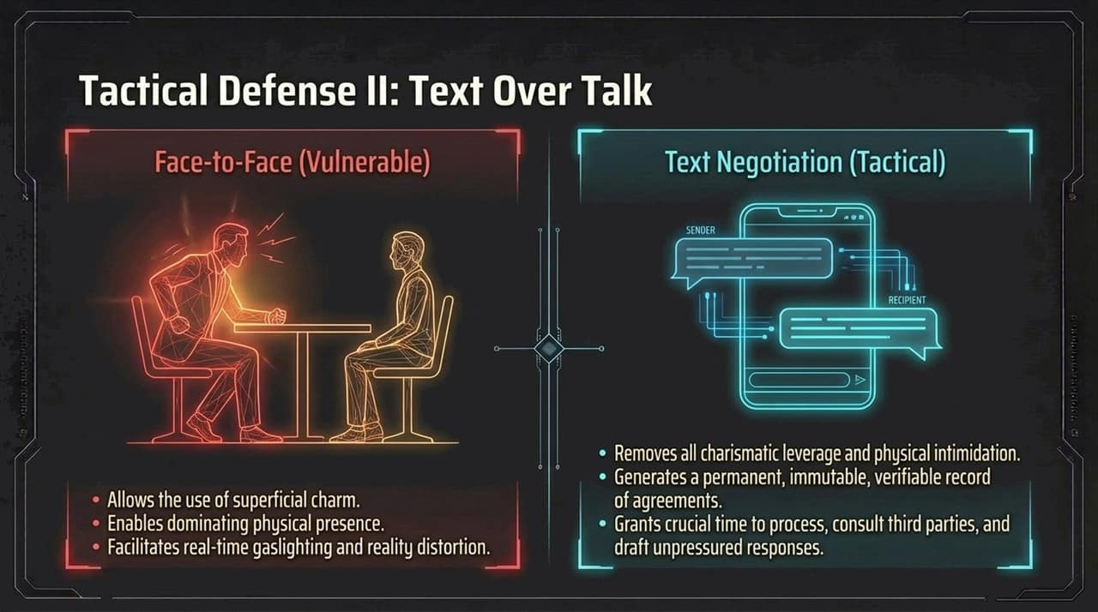
Notes:
In-Person Vulnerability: Face-to-face meetings give high-dark-trait individuals a major advantage. They can leverage physical presence, charismatic charm, micro-expressions, and real-time gaslighting to pressure you.
The Tactical Power of Written Communication:
Strip Away Charm: Written channels eliminate charismatic posture, vocal tone, and physical intimidation.
Create an Immutable Record: Creates a clear, verifiable audit trail of commitments, statements, and deadlines.
Provide Processing Time: Text negotiations give you time to consult third parties, review facts, and respond strategically rather than reactively.

Slide 14
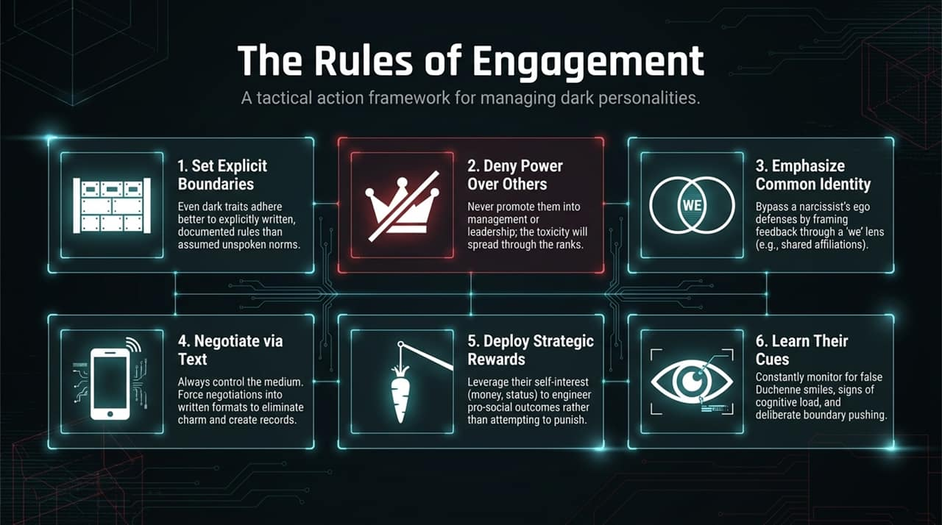
Notes:
Actionable Framework: Synthesizing our tactical defense into six core operational rules:
Set Explicit Boundaries: Documented, written rules work better than relying on unspoken social norms.
Deny Power Over Others: Avoid putting toxic traits into supervisory roles, as toxicity cascades down.
Emphasize Common Identity: Frame feedback through a collective "we" lens to bypass ego defenses.
Negotiate Via Text: Shift high-stakes interactions into written channels whenever possible.
Deploy Strategic Rewards: Align personal incentives with constructive behaviors.
Learn Their Cues: Watch for fake smiles, processing lags, and subtle boundary testing.

Slide 15
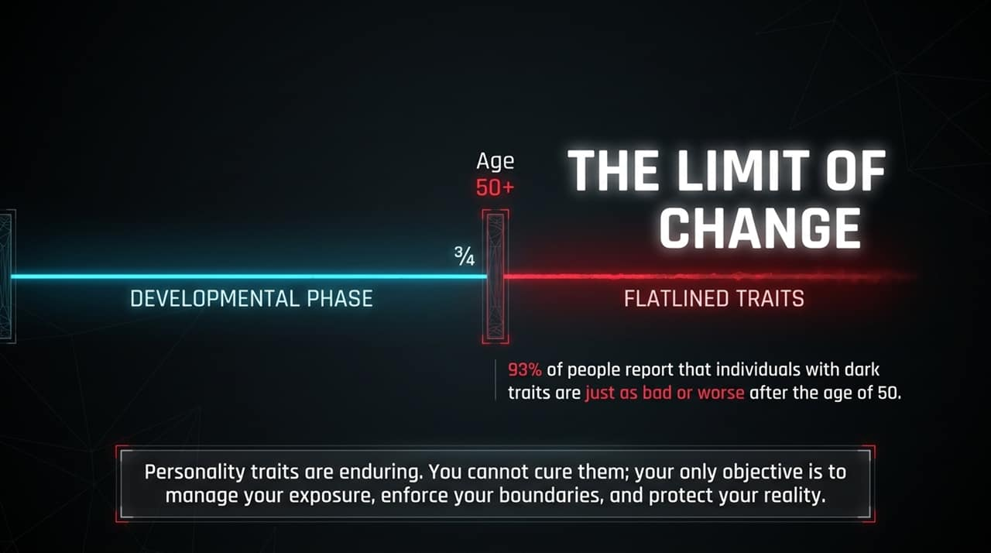
Notes:
Trait Stability Over Time: A common mistake is believing you can "fix" or reform a person with severe dark personality traits. Personality traits remain relatively stable across a lifespan.
The Age 50+ Flatline: Data shows 93% of people report that individuals with dark traits are just as bad—or worse—after the age of 50.
Final Reality Check: You will not cure a dark personality. Your primary duty is to protect your team, manage your exposure, enforce clear boundaries, and keep your perception of reality intact.

Slide 16
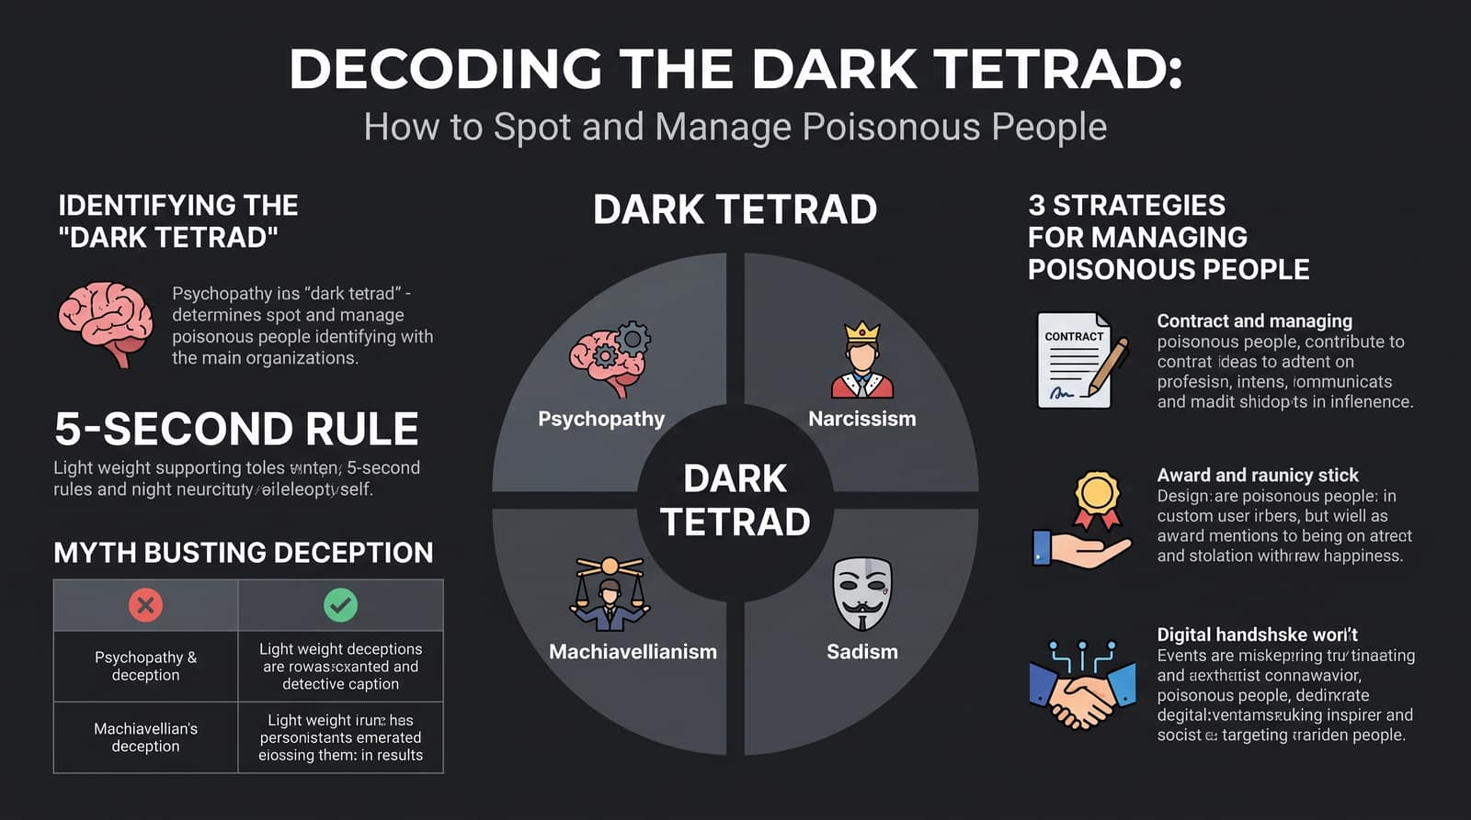
Notes:
https://www.youtube.cExecutive Recap: We've surveyed the landscape of deception and dark personalities, moving from general myths to actionable behavioral science.
Core Takeaways:
Spotting Deception: Focus on statement verifiability, cognitive processing lag, and open-ended probing rather than outdated myths like eye contact.
Understanding the Profiles: Recognize the distinct drivers of Psychopathy, Machiavellianism, Narcissism, and Sadism.
Strategic Management: Shift negotiations to text, rely on reward structures over punishment, and set firm, written boundaries.
Conclusion: By taking away the leverage of charm and emotional manipulation, we build safer, healthier, and more productive environments. Thank you.
om/watch?v=AcK_zgJjnoo

